Slide 1
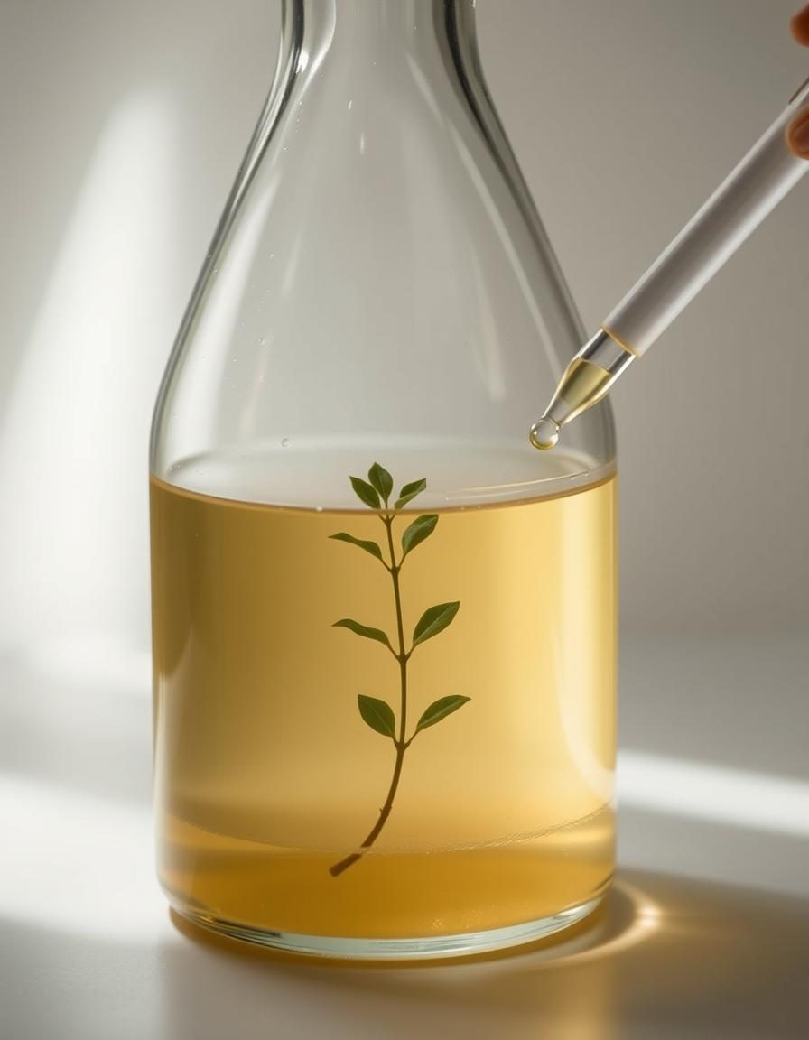
Extraction techniques of medicinal plants
Ass. Lecturer. Riham Adnan
2025

Slide 2
EXTRACTION
Extraction of medicinal plants: is a process of separating active plant materials or secondary metabolites such as alkaloids, flavonoids, terpenes, saponins, steroids, and glycosides from inert or inactive material using an appropriate solvent and standard extraction procedure.
The products obtained from plants are relatively impure liquids, semisolids, or powders intended only for oral or external use (why?).
The solvent used in the extraction is called Menstruum.
The inert fibrous and other insoluble materials remaining after the extraction are called Marc

Slide 3
Can we use that extract directly?
Add your central idea
Yes
No

Slide 4
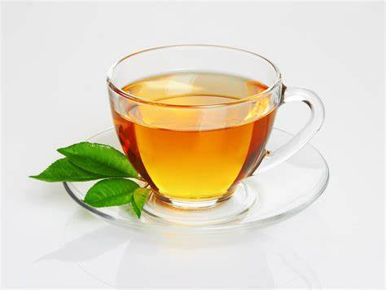
Give me examples from your life

Slide 5

Think again !

Slide 6
The extract thus obtained may be ready for use either as a medicinal agent in the form of tinctures and fluid extracts, or it might be further processed to be incorporated in any dosage form such as tablets or capsules, or it might be fractionated to isolate individual chemical entities such as hyoscine and vincristine, which are modern drugs.
Thus, standardization of extraction procedures contributes significantly to the final quality of the herbal drug

Slide 7
Extraction techniques
Solvent extraction is the most widely used method.
The extraction of natural products progresses through the following stages:
the solvent penetrates into the solid matrix;
the solute dissolves in the solvents;
the solute is diffused out of the solid matrix;
the extracted solutes are collected.

Slide 8




Hot techniques
decoction
Cold techniques
maceration
digestion
Soxholet appararus
infusion
Extraction techniques
distillation
percolation
Reflux extraction
Ultrasound assisted extraction
Microwave assited extraction

Slide 9
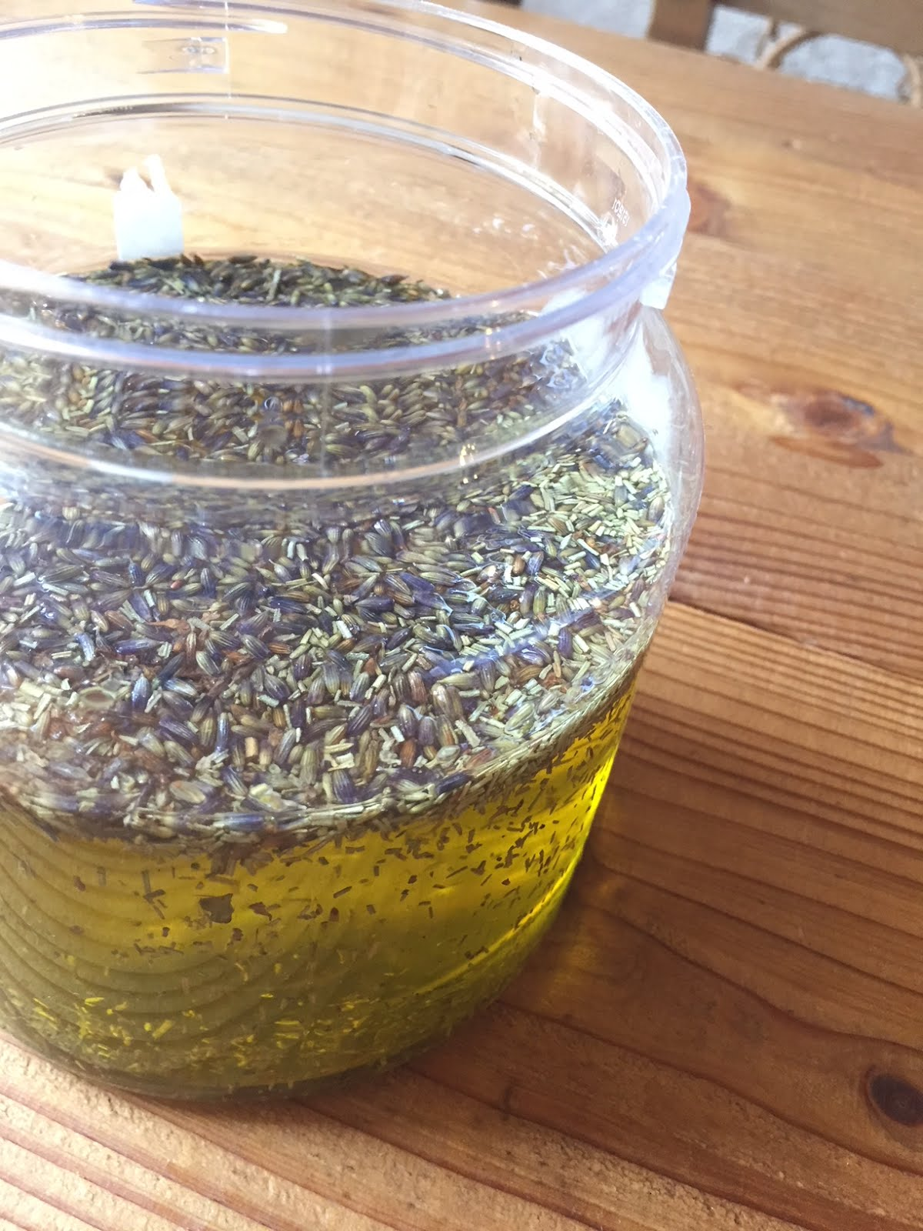
Maceration
In this process, the whole or coarsely powdered crude drug is placed in a stoppered container with the solvent and allowed to stand at room temperature for a period of at least 3 days with frequent agitation until the soluble matter has dissolved. The mixture then is strained to collect the filtrate.

Slide 10
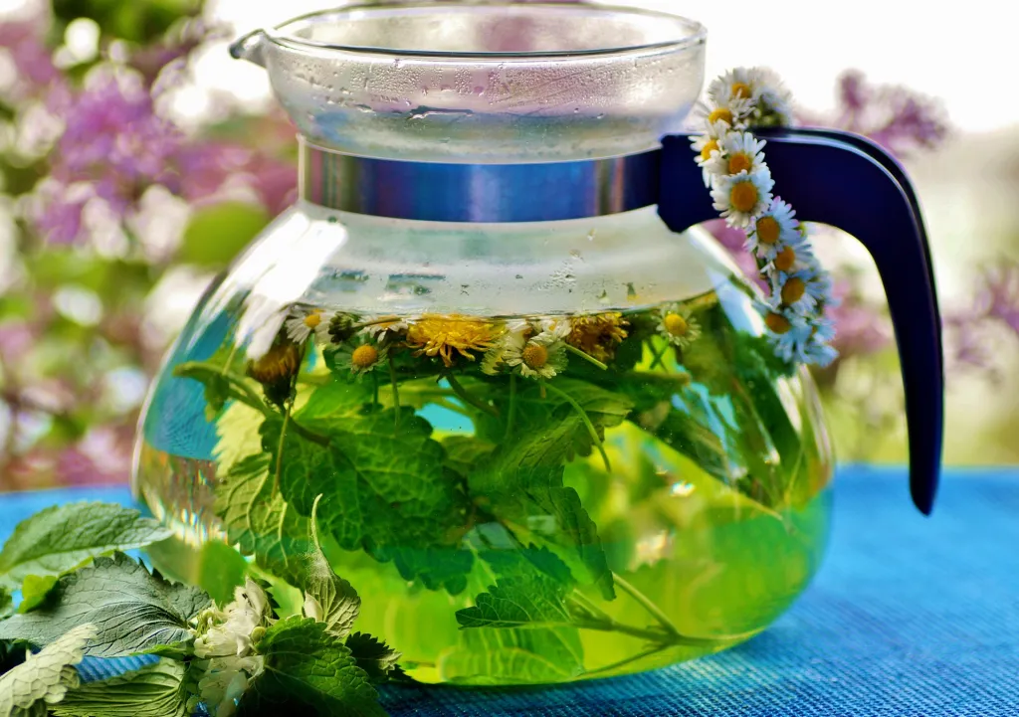
Infusion
Fresh infusions are prepared by macerating the crude drug for a short period of time with cold or boiling water. These are dilute solutions of the readily soluble constituents of crude drugs.

Slide 11
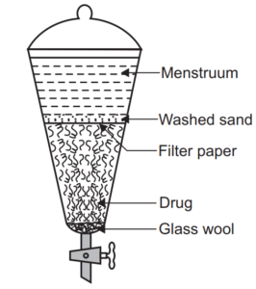
Percolation
H.W. What is the extraction by percolation
?

Slide 12
Decoction
Decoction In this process, the crude drug is boiled in a specified volume of water for a defined time; it is then cooled and strained or filtered. This procedure is suitable for extracting water-soluble, heatstable constituents. This process is typically used in preparation of Ayurvedic extracts. The starting ratio of crude drug to water is fixed, e.g. 1:4 or 1:16. Then, the concentrated extract is filtered and used as such or processed further .

Slide 13
Digestion
This is a form of maceration in which gentle heat is used during the process of extraction. It is used when moderately elevated temperature is not objectionable. The solvent efficiency of the menstruum is thereby increased.

Slide 14
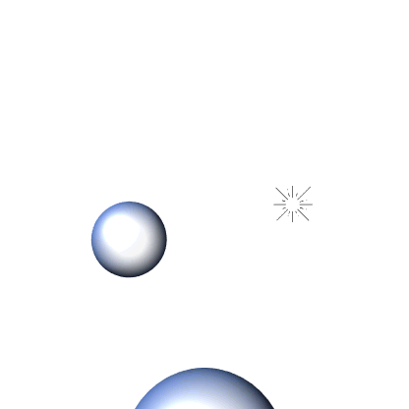
Ultrasound assisted extraction
This process involves applying sound energy at a very high frequency greater than 20 KHz to disrupt the plant cell wall and increase the drug surface area for solvent penetration.
In ultrasound-assisted extraction, dried and ground plant material is combined with a solvent and subjected to ultrasound waves. These waves create alternating high and low-pressure cycles in the liquid, resulting in the formation and subsequent violent collapse of microscopic bubbles (a process known as cavitation). The force from this collapse disrupts plant cell walls, allowing the cell's contents to be released into the solvent.

Slide 15
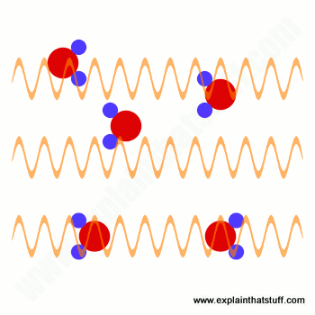
Microwave assisted extraction
Microwaves are electromagnetic radiations with a frequency between 300 MHz and 3000 GHz
The plant material is immersed in the polar solvent inside the container. When microwave radiation bombards the solvent, this solvent absorbs electromagnetic energy and converts it into heat. Subsequently, the heat produced increases the movement of solvent into the plant. However, when nonpolar solvent is used, the microwave radiation released will produce only small heat; hence, this method does not favor the use of nonpolar solvents.

Slide 16
How to choose from these methods?
The choice of an appropriate extraction method depends on the
1- nature of the plant material,
2-solvent used,
3-pH of the solvent,
4- temperature,
5-solvent to sample ratio.
6-It also depends on the intended use of the final products

Slide 17
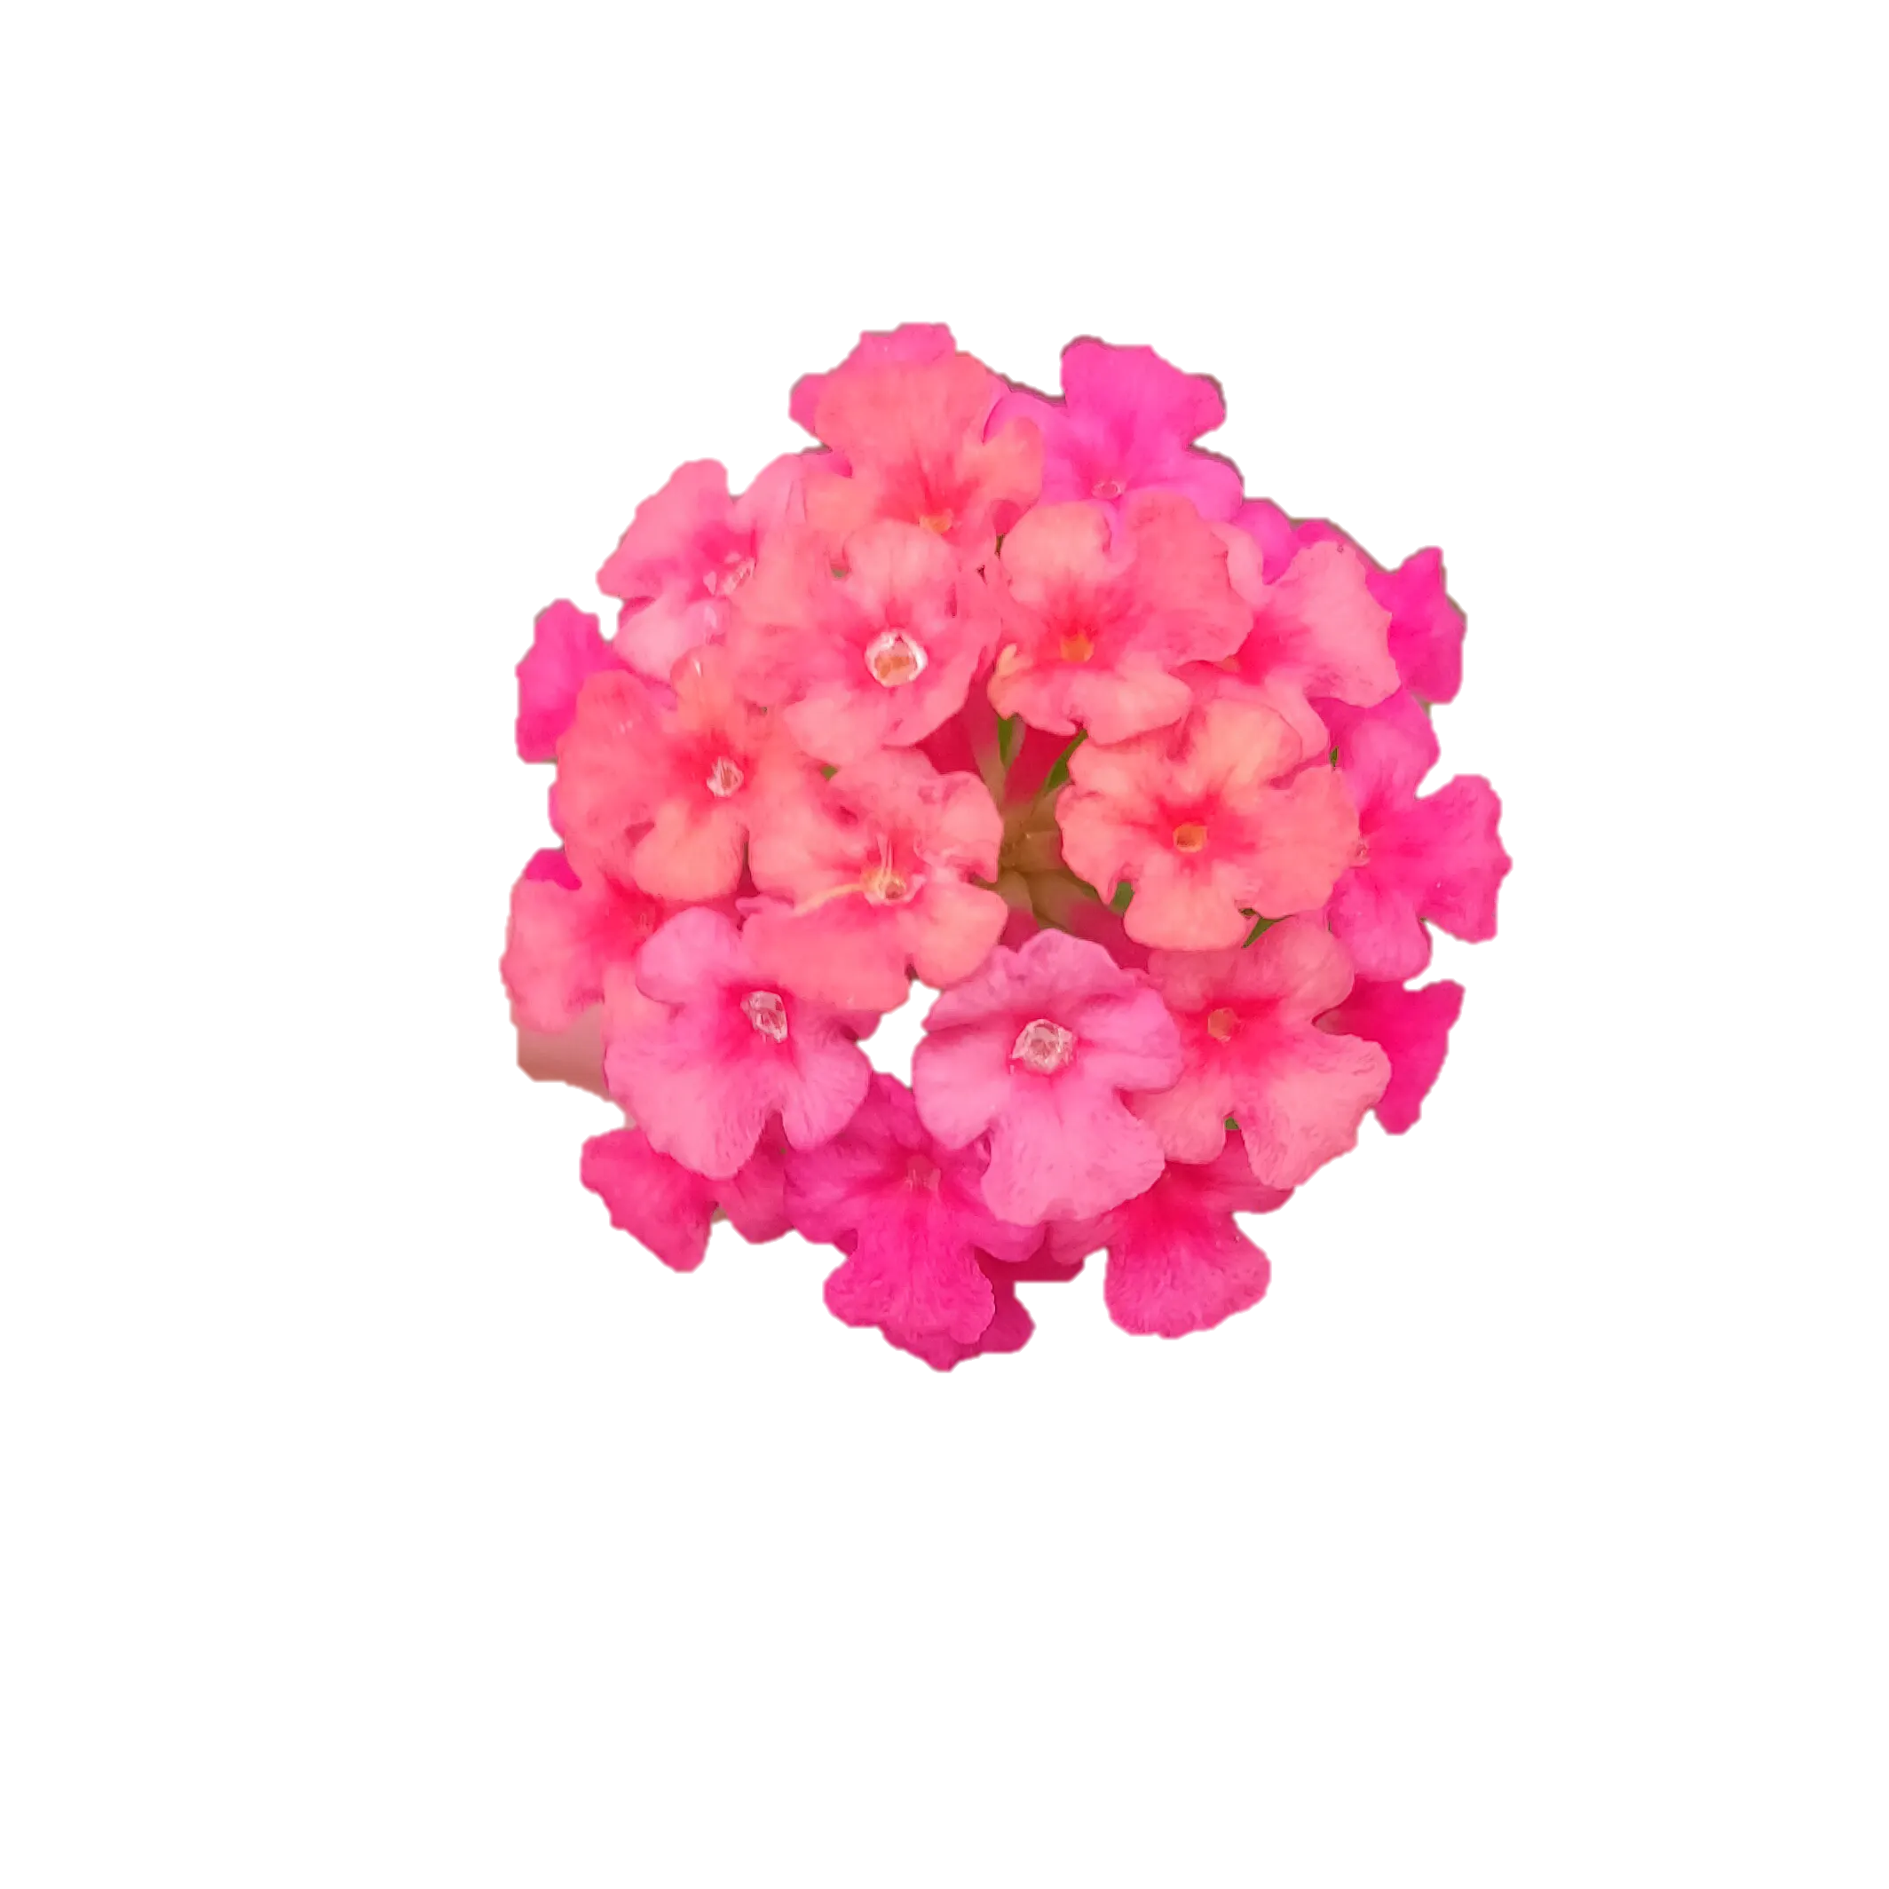
Practical part
Plants used
1/lantana camara (Common name big-sage)
part used : flowers
Medicinal uses: The leaf oil is used as an antiseptic for wounds and the roots are used for the treatment of tooth ache and the flowers for chest complaints in children

Slide 18
Extraction technique
Maceration
to 0.25 gm of the plant add 10 ml 70% ethanol, leave for 3 days, then strain and collect the filterate. Let the filterate dry in a Petri dish till the next lab., then collect and weigh to calculate the extraction yield

Slide 19
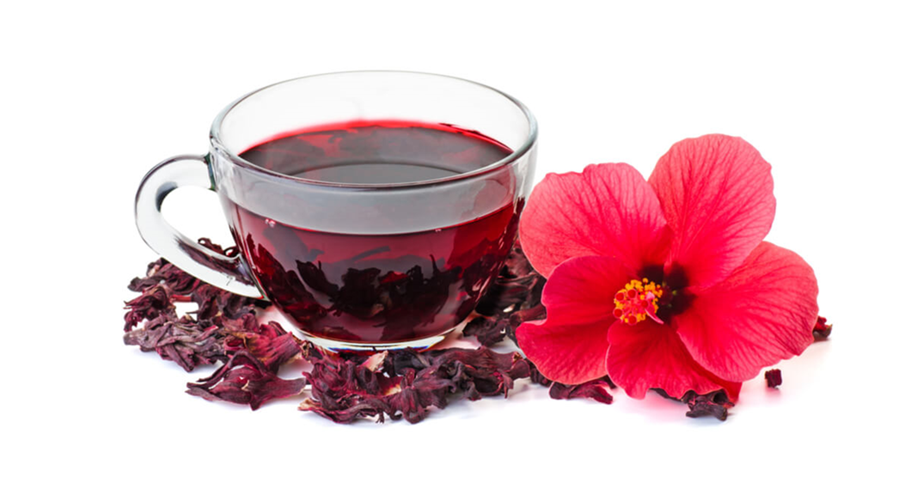
Practical part
Plants used
2/Hibiscus sabdariffa (common name Roselle)
part used : flowers
Medicinal uses: used in folk medicine as a diuretic and mild laxative, as well as in treating cancer and cardiac and nerve disease

Slide 20
Extraction technique
Ultrasound-assisted
to 0.25 gm of the fresh leaves add 10 ml 70%ethanol in a beaker, move it to the ultrasound apparatus and set it to 120 Hz for 5 min at 30 C, then strain and collect the filterate. Let the filterate dry in a petridish till the next lab., then collect and weigh to calculate the extraction yield.

Slide 21
Extraction yield
Yield = weight of the extract X 100%
weight of the plant

Slide 22


